Slide 1
Git
JDU

Slide 2
What is GIT
A Revision Control System

Slide 3
What is GIT
A Distributed Revision Control System

Slide 4
Our Workflow
Shared Repository
Developer
Developer
Developer

Slide 5
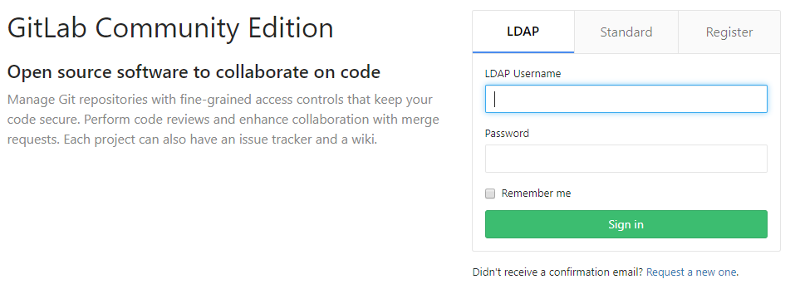
Repository Manager

Slide 6



Git Client

Slide 7
Branch Operation (PG～PT Phase)
TL | Developer-in-Charge
Create the “master” branch
Conflict?
Y
Create a "develop" branch
from the "master"
Acquire the common repository
from Gitlab,
and create a local repository.
Add the modified in the index
of the local repository.
N
Resolve the file
conflict in the
local repository
Create a "feature" branch
from the "develop" branch.
Commit the modified file
to the local repository.
A
Change the task branch of the
local repository
to "feature" branch.
Fetch to acquire the latest
state of the shared repository.
Merge from the develop branch
Add/Modify the function at the
local repository,
then conduct PT.
Pull to acquire the reflected
modifications in the "develop"
branch of the shared repository.
Push to the shared repository
Examine the contents of the
received merge request, and
review the modification module
Send a merge request to merge the
modifications made in the "feature"
branch to the "develop" branch
Problem?
Y
A
N
Approve the merge request
and merge it into the
development branch.
Delete feature branch

Slide 8
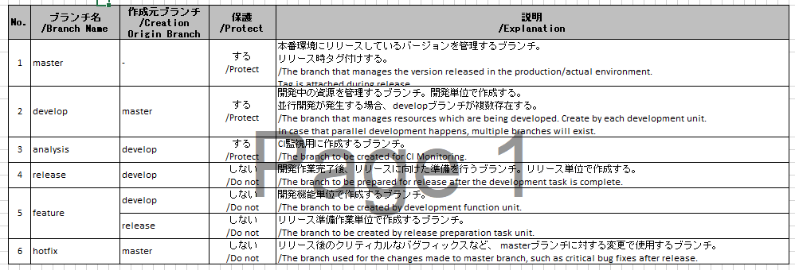
Branch Configuration Design
In JDU, the branches to be used are listed below :

Slide 9
Create the master branch
Create a group
Create the project inside the group

Slide 10
Create a develop branch
For the branches other than "master", create by development project and function unit.
The following naming conventions are written below to have unique numbering:
"develop" Branch
Development Project Management Branch
Format: "develop_" + {Development Project Name}
For the {Development project name}, use single-byte alpha-numeric characters.
Example:
If the development project name is "Dev-Project“ use –
develop_Dev-Project

Slide 11
Protected Branches
The branches that are protected are listed below:

Slide 12
Branch Operation (PG～PT Phase)
TL | Developer-in-Charge
Create the “master” branch
Conflict?
Y
Create a "develop" branch
from the "master"
Acquire the common repository
from Gitlab,
and create a local repository.
Add the modified in the index
of the local repository.
N
Resolve the file
conflict in the
local repository
Create a "feature" branch
from the "develop" branch.
Commit the modified file
to the local repository.
A
Change the task branch of the
local repository
to "feature" branch.
Fetch to acquire the latest
state of the shared repository.
Merge from the develop branch
Add/Modify the function at the
local repository,
then conduct PT.
Pull to acquire the reflected
modifications in the "develop"
branch of the shared repository.
Push to the shared repository
Examine the contents of the
received merge request, and
review the modification module
Send a merge request to merge the
modifications made in the "feature"
branch to the "develop" branch
Problem?
Y
A
N
Approve the merge request
and merge it into the
development branch.
Delete feature branch

Slide 13
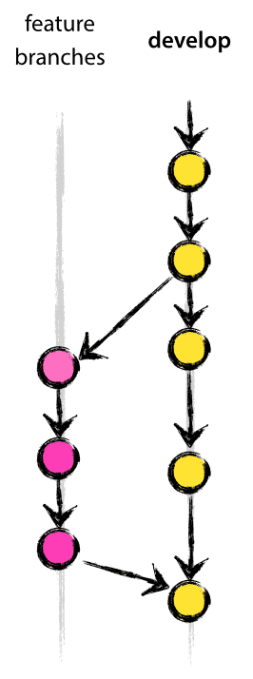
Branch Operation (PG～PT Phase)
https://nvie.com/posts/a-successful-git-branching-model/

Slide 14
Git Commands
Commands | Description
git-clone | Clone a repository into a new directory
git-branch | List, create, or delete branches
git-commit | Record changes to the repository
git-push | Update remote refs along with associated objects
git-pull | Fetch from and integrate with another repository or a local branch
git-merge | Join two or more development histories together
git-reset | Reset current HEAD to the specified state

Slide 15
Branch Naming Convention
feature Branch
Development Function For Management Branch
Format: "feature_" + {Development Project Name} + "_func#" + {Ticket Number}
For the {Development project name}, use single-byte alphanumeric characters.
For the {Ticket Number}, use the ticket number for the development function which is managed in Redmine.
Example:
In case of creating the ticket number "1234" in the development project name "Dev-Project“, use
feature_Dev-Project_func#1234

Slide 16
Branch Merging
Depending on the branch usage
No. | ブランチ名 /Branch Name | マージ先ブランチ /Merge Destination Branch | 説明 /Explanation
1 | master | - | 本番環境にリリースされているバージョンのため、他ブランチへのマージは発生しない。 /Since this is the version released in the production/actual environment, merging into other branches does not occur.
2 | develop | release | hotfixでの修正はdevelopに対してマージを行うため、リリース準備中の場合、releaseに対してマージする。 /Modification/Correction with hotfix will merge for each develop, in case of release preparation, merge for each release.
 |  | develop | 開発が並行して進む場合、先行してリリースする開発の修正内容を後発の開発で取込む必要があるため、後発のdevelopに対してマージが発生する。 /In case of developments which are progressing in parallel, it is necessary to incorporate the modification contents of the preceding development to be released in the succeeding development, a merge will occur in the succeeding "develop".
3 | analysis | - | CI監視用に作成するため、他ブランチへのマージは発生しない。 /Since this is created for CI monitoring use, merging into other branches will not occur.
4 | release | master | リリース準備作業が完了し、本番環境へリリースするモジュールをマージする。 /Merge for the module to be released to the production/actual environment, and the release preparation work is completed.
 |  | develop | リリース準備作業中に発生した修正をdevelopにフィードバックする必要があるため、developにマージする。 /Since it is necessary to feedback the modifications that occurred during the release preparation task, merge it to develop.
5 | feature | develop | 開発機能単位でモジュールの開発を行い、developへmerge requestを行う。 merge requestを行うことで、レビューを実施した変更内容のみマージする。 /Perform the development of modules by units of development functions, and make merge requests to 'develop'. Through merge request, only the changes made brought about by the review are merged.
 |  | release | リリース準備作業での変更をマージする。 /Merge changes in the release preparation work.
6 | hotfix | master | 現行のプロダクトへの変更のためmasterに対してマージを行う。 /Perform the merge to the master for the changes to the current product.
 |  | develop | developに対してマージすることでデグレードを予防する。 /Prevent degradation by merging for each "develop".
 |  | hotfix | 本番メンテナンスが並行して進む場合、先行してリリースする修正内容を後発の本番メンテナンスで取込む必要があるため、後発のhotfixに対してマージが発生する。 When the main maintenance progresses in parallel, it is necessary to incorporate the modification contents of the preceding development to b released to the succeeding production maintenance, so a merge occurs for the succeeding hotfix.

Slide 17
Commit Message Conventions *
This defines the commit message rules to be set when committing the modification contents in the task branch.
Objective
By properly writing the description of the modification, it will be easy to understand the content of the modification even when viewed by other people who are not in-charge of the modification.
In the commit message, do not just write that you did a modification, write what you modified and the reason why that modification was necessary.
The purpose is to be able to easily know the modification contents from the change history of the Git repository.

Slide 18
Commit Message Conventions
For more details on the convention please refer to the attached file:

Slide 19
Commit Message Conventions
The seven rules of a great Git commit message
Separate subject from body with a blank line.
Limit the subject line to 50 characters.
Capitalize the subject line.
Do not end the subject line with a period.
Use the imperative mood in the subject line.
Wrap the body at 72 characters.
Use the body to explain what and why vs. how.

Slide 20
Branch Merging
 |  |  |  |  |  |  |  |  |  | マージ元となるブランチ（先発プロジェクト） Branches to be merged (Preceding development project)
 |  |  |  |  |  |  |  |  |  | PG/PT工程 PG/PT Phase (develop) |  |  |  |  |  |  |  |  |  |  |  |  |  |  | IT/ST/OT工程 IT/ST/OT Phase (develop) |  |  |  |  |  |  |  |  |  |  |  |  |  |  | リリース準備 /Release Preparation (release) |  |  |  |  |  |  |  |  |  |  |  |  |  |  | 本番メンテナンス /Production Maintenance (hotfix)
作業ブランチ/Task Branch （後発プロジェクト）/Subsequent Development Project |  |  | PG/PT工程 /PG/PT Phase (develop) |  |  |  |  |  |  | ブランチ運用手順（PG-PT工程） 「開発プロジェクトが並走した場合のマージ」 /Branch operation procedure (PG - PT Phase) "Merge when development projects run in parallel" |  |  |  |  |  |  |  |  |  |  |  |  |  |  | ブランチ運用手順（PG-PT工程） 「開発プロジェクトが並走した場合のマージ」 /Branch Operation Procedure (PG-PT Phase) "Merge when development projects run in parallel" |  |  |  |  |  |  |  |  |  |  |  |  |  |  | ブランチ運用手順（PG-PT工程） 「先行プロジェクトのリリース準備内容を反映するためのマージ /Branch Operation Procedure (PG-PT Phase) "Merge to reflect release preparation contents of the preceding project" |  |  |  |  |  |  |  |  |  |  |  |  |  |  | ブランチ運用手順（PG-PT工程） 「masterブランチでの修正が発生した場合のマージ」 /Branch Operation Manual (PG-PT Phase) "Merge when modifications occurred in the master branch"
 |  |  | IT/ST/OT工程 /IT/ST/OT Phase (develop) |  |  |  |  |  |  | ※ブランチ運用手順（PG-PT工程） 「開発プロジェクトが並走した場合のマージ」 /*Branch Operation Procedure (PG-PT Phase) "Merge when development projects run in parallel" |  |  |  |  |  |  |  |  |  |  |  |  |  |  | ※ブランチ運用手順（PG-PT工程） 「開発プロジェクトが並走した場合のマージ」 /*Branch Operation Procedure (PG-PT Phase) "Merge when development projets run in parallel" |  |  |  |  |  |  |  |  |  |  |  |  |  |  | ※ブランチ運用手順（PG-PT工程） 「先行プロジェクトのリリース準備内容を反映するためのマージ」 /*Branch Operation Proceure (PG-PT Phase) "Merge to reflect release preparation contents of the preceding project" |  |  |  |  |  |  |  |  |  |  |  |  |  |  | ※ブランチ運用手順（PG-PT工程） 「masterブランチでの修正が発生した場合のマージ」 /Branch operation procedure (PG-PT Phase) "Merge when modifications occurred in the master branch"
 |  |  | リリース準備 /Release Preparation (release) |  |  |  |  |  |  | 後発プロジェクトのマージは不要 /Merging of subsequent development projects is not necessary |  |  |  |  |  |  |  |  |  |  |  |  |  |  | 後発プロジェクトのマージは不要 /Merging of subsequent development projects is not necessary |  |  |  |  |  |  |  |  |  |  |  |  |  |  | リリース準備を並行して実施しない /Do not implement release preparations in parallel |  |  |  |  |  |  |  |  |  |  |  |  |  |  | ブランチ運用手順（リリース作業） 「masterブランチでの修正が発生した場合のマージ」 /Branch Operation Procedure (Release Task) "Merge when modifications occurred in the master branch"
 |  |  | 本番メンテナンス /Production Maintenance (hotfix) |  |  |  |  |  |  | 開発中資源はマージは不要 /Merging for resources which are still under development is not necessary |  |  |  |  |  |  |  |  |  |  |  |  |  |  | 開発中資源はマージは不要 /Merging for resources which are still under development is not necessary |  |  |  |  |  |  |  |  |  |  |  |  |  |  | 開発中資源はマージは不要 /Merging for resources which are still under development is not necessary |  |  |  |  |  |  |  |  |  |  |  |  |  |  | ブランチ運用手順（本番メンテナンス） 「並行対応中のhotfixブランチへのマージ」 /Branch Operation Procedure (Production Maintenance) "Merge to parallel hot-fix branches"

